Slide 1
Winning Marketing Strategies Using Generative AI

Slide 2
THE BASIS OF TRADE
Economic Trade Has Certain Elements
A Need For A Product or Service Must Exist
There Must Be A Benefit To All Parties For An Exchange Of Products/Services To Take Place
There Must Be A Means Of Of Informing The Potential Customer Of The Offerings
There Must Be A Means Of Conducting The Transaction (Delivering The Goods And Collecting The Value Exchange)

Slide 3
MARKETING
    MARKETING IS NOT JUST ADVERTISING AND PROMOTION
            Marketing Is A Process To Support Economic Trade. For Trade To Exist There Has To Be Means Of Production (Product/Service), Delivery (Place), Communication That The Product Exists (Promotion) And A Metric For Value (Price).
            As You Might Suspect, To Implement These 4 Ps (Price, Place, Product and Promotion) You Will Need To Understand Some Finance, Accounting, Supply Chain, Merchandising, Legal Requirements, Research, Management, Operations, Inventory Levels And So On.
            By Pursuing A New InitiativeYou Will Learn How All Of These Elements Can Be Considered And Implemented Using A Process, Moving From Idea To Execution.

Slide 4
START OF THE PROCESS: MVOSSTE
Mission
Vision
Objective
Situation Analysis
Strategy
Tactics
Execution

Slide 5
Mission

Slide 6
Mission
A Mission Statement Provides A Guiding Light For Executives And Strategists To Build An Enterprise

Slide 7
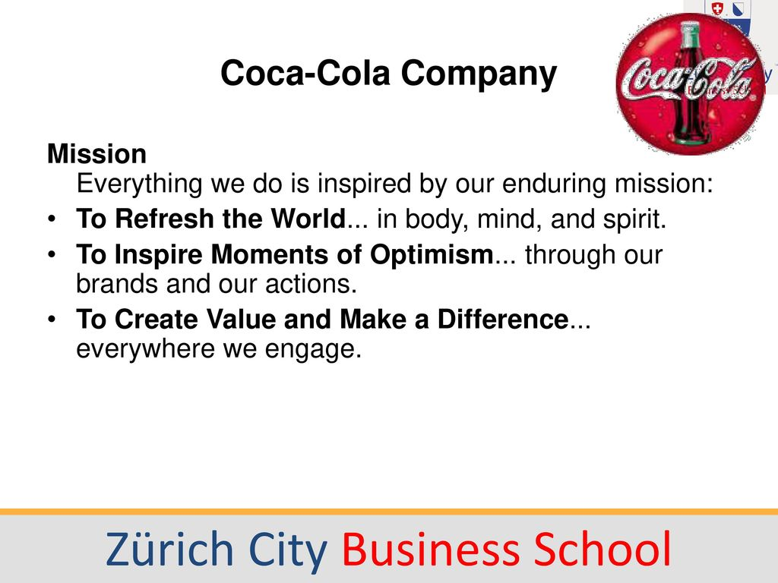

Slide 8

Create a Mission Statement
Create A Mission Statement For Your Organization
This Statement Should Describe What Your Organization Wants To Accomplish
You Can Ask Your AI Tool To Create A Mission Statement By Asking It To Do So After Describing Your Company.
Example Of A Prompt For AI: “Create A Mission Statement For A Company Wishing To __________”
Notes:
The mission statement can be based on an idea or a company already in business.
To create a mission statment start with what you intend to do. For example, We would like to serve pet owners with a myriad of products and services.

Slide 9
Vision

Slide 10
Vision
A Vision Statement Provides A Description Of How An Organization, Following The Mission Statement, Will Create Value For The Organization, Its Customers And Its Collaborators.

Slide 12
Create a Vision Statement
Create A Vision Statement For Your Organization
This Statement Should Indicate How Your Organization Will Create Value For Your Customer, Your Collaborators And Your Organization.
You Can Ask Your AI Tool To Create A Vision Statement Based On The Mission Statement And The Product Or Service You Plan To Provide.
Example Of A Prompt For Ai: “Create A Vision Statement For The Organization In The Mission Statement That Will Show How We Will Create Value For The Company, The Customers And The Collaborators.”

Slide 13
Objective

Slide 14
Objective
An Objective Is A Goal An Organization Wishes To Achieve.
The Objective Should Be In Alignment With The Mission And Vision Of The Organization.
The Objective Should Have A Time Frame To For Achieving The Goal
The Objective Should Have Metrics To Determine The Level Of Success

Slide 15
State Your Objective
Specifically Define The Goal You Wish To Reach
  Start A Company
  Reach A Revenue Goal
  Reach A New Market
  Rebrand
  The Objective Should Have A Time Line And A Metric (Eg. Grow Revenue 10 % In One Year)

Slide 16
State Your Objective
You Can Use Your AI Tool To Help In Stating Your Objective,
An Example Of A Prompt For AI: “Provide A One Year And Five Year Objective For My Organization that aligns with our mission and vision statements Including Metrics For Success”
You Can Adjust, Restate Or Reject The AI Provided Objective. If You Aren’t Satisfied You May Want To Revisit Your Mission And Vision Statements.

Slide 17
Situation Analysis

Slide 18
SITUATION ANALYSIS
What Is Your Value - What Is The Job To Be Done
What Is Your Market - Who Will Want This Job Done
Is This Product A Disruptor?
https://www.youtube.com/watch?v=qDrMAzCHFUU
Are There Potential Disruptions That Could Be Exploited By Their Client
Who Are The Least Profitable Customers For The Industry Leaders?
What Research Is Needed?
Does This Product Create A Blue Ocean Opportunity?
https://www.youtube.com/watch?v=clp-IMpuwaQ
                Do Blue Oceans Exist For The Your Clients?
                What Research Is Needed?
Notes:
This slide indicates the types of questions that need to be answered before developing a strategy. Watch the two videos in the links.

Slide 19
SITUATION ANALYSIS
Mckinsey Hypothesis Tree - A Decision Tree Approach To Determine Mutually Exclusive, Collectively Exhaustive Options To Reach An Objective
Core Competencies - What Core Competencies Will Be Needed To Reach The Objective
Porter’s 5 Forces - What Market Forces Will Affect Reaching The Objective
Blue Ocean Canvas
DIsruptive Innovation Analysis
Surveys And Secondary Research - Who Are The Customers? What Are Their Psychographic And Demographic Attributes?
Notes:
These are a few of the research approaches that can be used to answer the question: “ What information will provide the best foundation to develop a strategy?” You can also ask AI to create an Hypothesis Tree, Blue Ocean Canvas or develop a survey questionnaire.

Slide 20
Situation Analysis
You can Use AI to identify the research needed
  Examples of prompts for AI
  “Create an MECE Hypothesis tree for best revenue opportunities for this company”
  “What are the core competencies required for this initiative?”
  “What research is required to determine the target market and market size?”

Slide 21
HYPOTHESIS TREE

Slide 23
Core Competencies
What Core competencies will be needed to reach your mission, Vision and objective?
How will you acquire these competencies within the time line to reach your objective.
You can use your AI tool to identify needed competencies and how they might be acquired with the resources and timeline dictated by your organization.

Slide 24
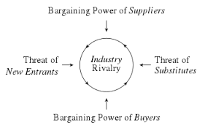
PORTER’S FIVE FORCES

Slide 25
Blue Ocean Canvas

Slide 26
Disruptive Innovation Analysis
What Are The Least Profitable Products Produced By Your Competitors?
Can We Make A Higher Profit Margin By Providing The Same Product Through Innovation?
How Large Is The Market For Products Provided By The Market Leaders?
What % Of This Market Would Accept A “Good Enough” Product At A Lower Price That Would Provide Us With A Sustainable Profit Margin resulting from Innovation?
Notes:
You might review the Christensen film in Slide # 14.

Slide 27
Strategy

Slide 28
MARKETING STRATEGY
The Product, Price, Place And Promotion Strategies That Delivers Value To The Company, Its Customers And Collaborators.
Optimal Marketing Strategy - The Product, Price, Place And Promotion Strategies That Delivers Optimal Value To The Company, Its Customers And Collaborators.

Slide 29
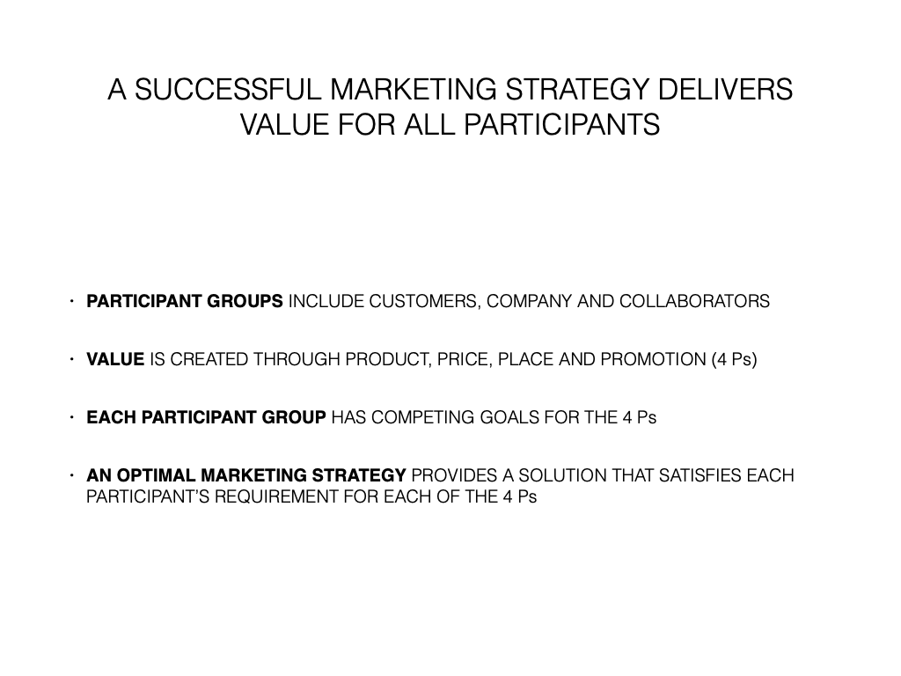

Slide 30
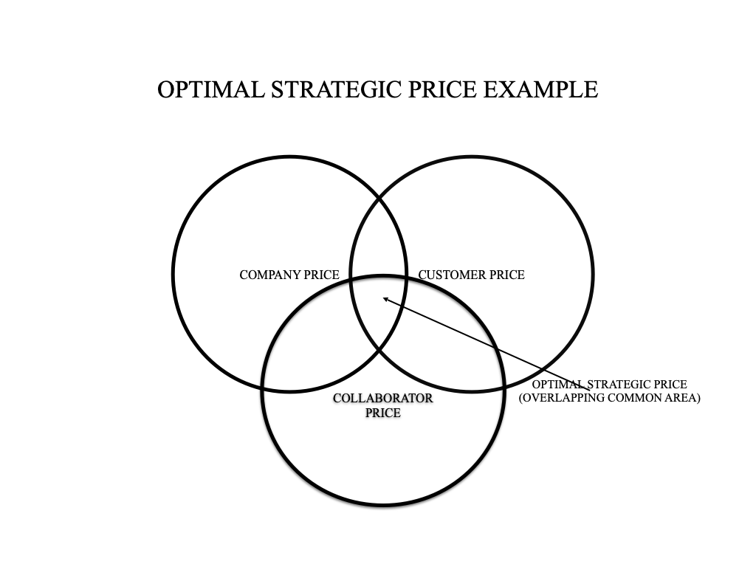

Slide 31
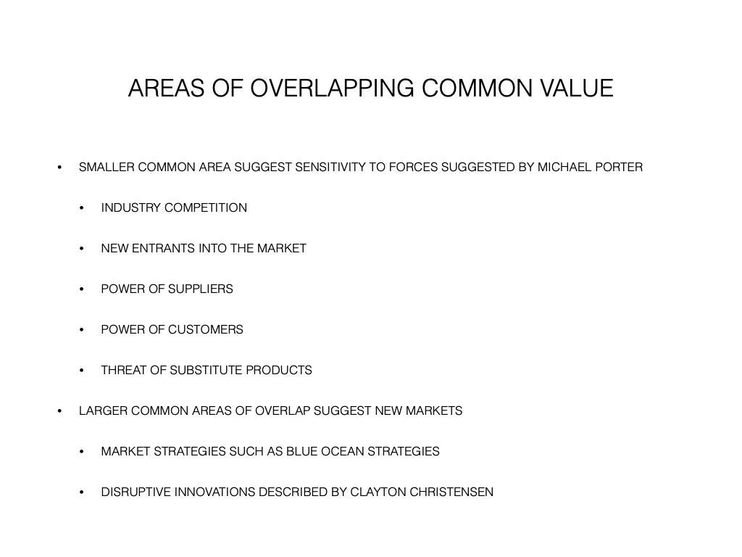

Slide 32
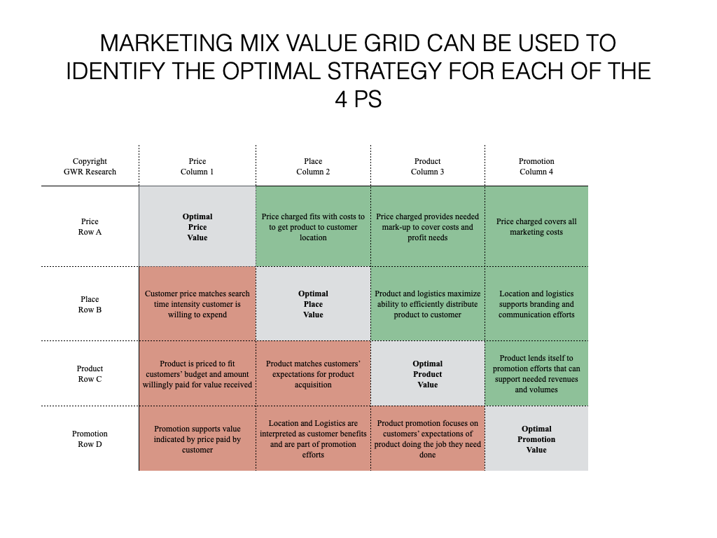
Areas in Green represent requirements for Company and Collaborators, Areas in Red represent requirements for Customers
Notes:
Note that each Optimal square must address the 6 squares that are aligned vertically and horizontally - three red and three green.

Slide 33
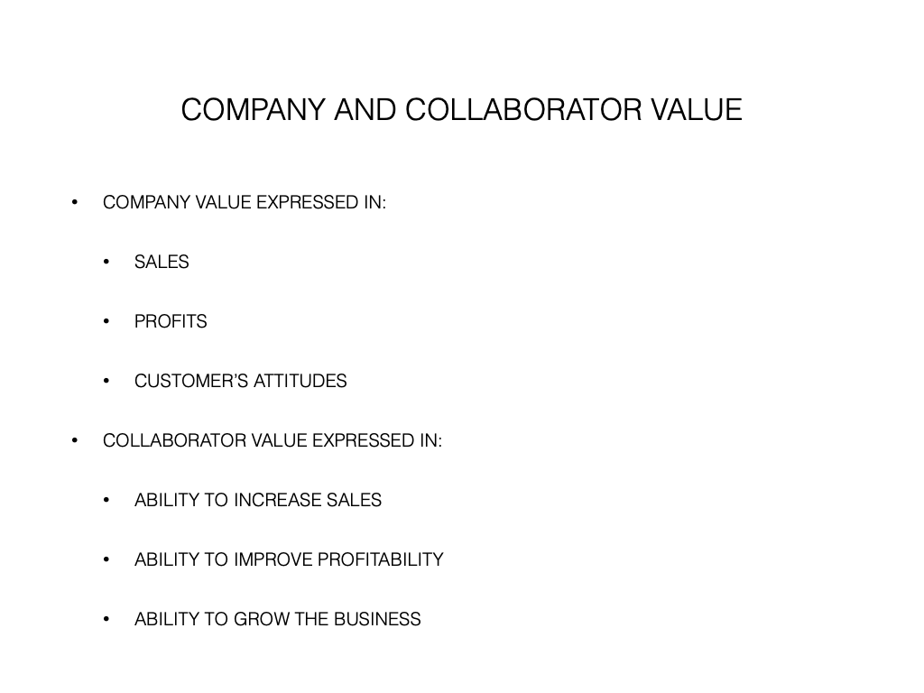

Slide 34
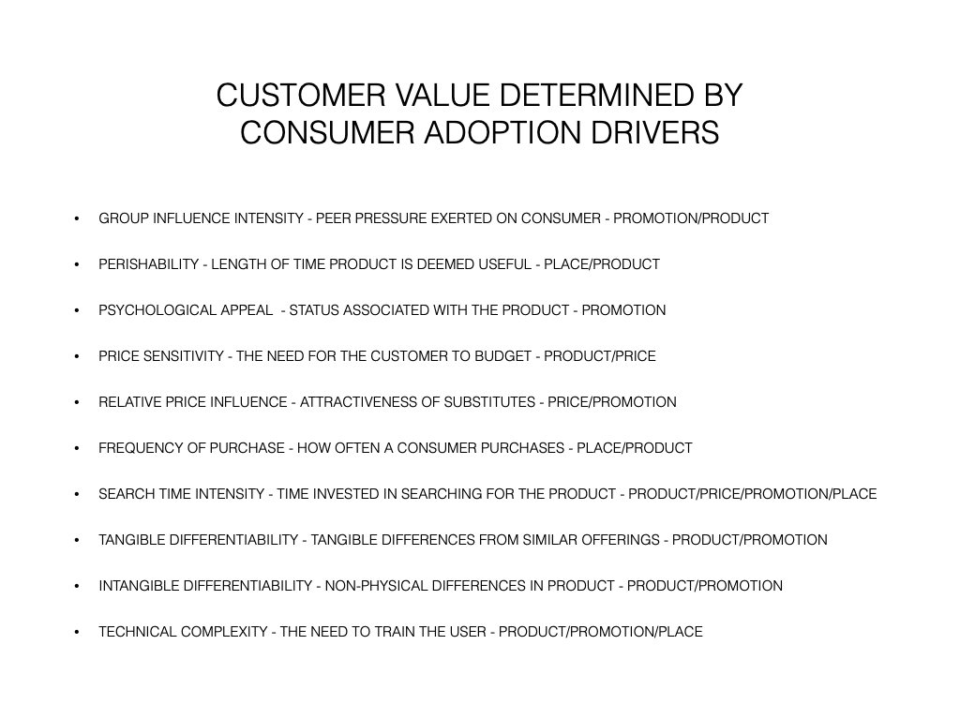

Slide 35
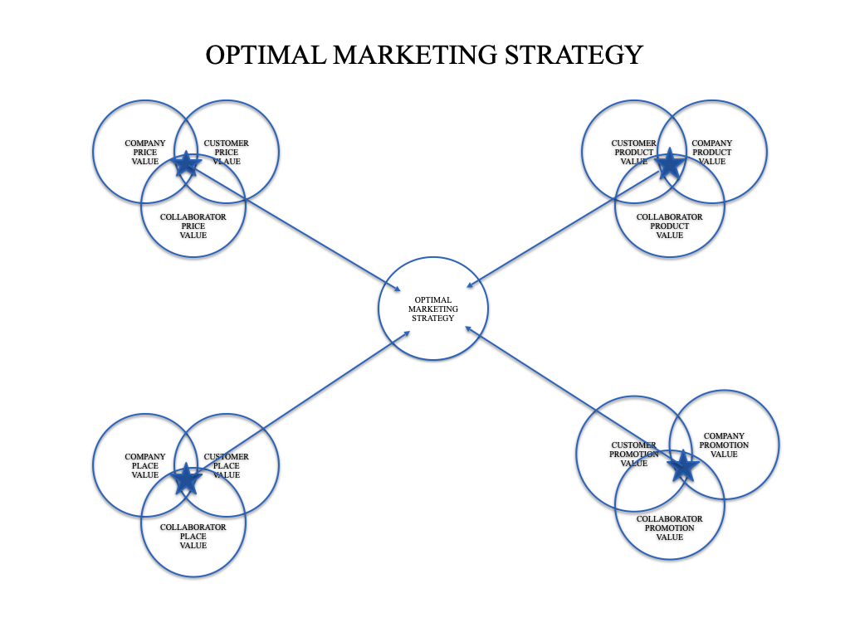

Slide 36
PRODUCT

Slide 37
Create a New Product or Service
What Job Will This Product Or Service Do?
Who Are The Potential Customers?
What Value Will Be Placed On Having This Job Done?
How Will The Customer Acquire This Product?
How Will Potential Customers Learn Of This Product?
Notes:
You might start with an AI exercise asking AI to identify products or services that would meet the mission, vision and objective previously established and based on the research identifying the target market and market needs.

Slide 38
Create a Product or Service
You Can Use Your AI Tool To Provide Ideas For Products Or Services That Will Help Reach Your Objective.
An Example Of A Prompt For AI: “Provide A Lists Of Products Or Services That Would Be In Alignment With My Mission And Vision And Reach My One And Five Year Objectives.”
Once Products And Services Are Identified Begin The Product Development Phase.
Notes:
The strategist may want to insure that products are supported by research on the target.

Slide 39
Product Development Exercise
Choose An Activity Based on Your Mission, Vision and Objective( E.G. Going On A Trip, Cooking A Meal Etc.),
Create A List Of Activities Required To Complete The Activity (E.G. Trip Itinerary, Packing Suitcase),
Choose One Activity To Make Better Or Easier,
Describe Worst Outcomes With This Activity (E.G. Can’t Find A Hotel, Destination Has Poor Local Travel Options)
Address The Bad Outcomes With A Solution
Is There A Product Or Service That Might Be Valuable To A Segment Of The Market?

Slide 40
New Product Development Process
EMPLOYEES
MARKET RESEARCH
“OUT OF THE BLUE”
CRITERIA FOR EVALUATING PROJECTS
PROFITABILITY/MARKET ACCEPTABILITY
ACCREDITATION REQUIREMENTS
LENGTH OF PROJECT
ACCOMMODATE SYSTEMS?
FIT IMAGE
RESOURCE REQUIREMENTS
GATEWAY CAPACITY
NEGATIVE GATEWAY CAPACITY
PROJECT IDEAS
TASK GROUP:SALES, SYSTEMS, RESEARCH, FINANCE, PRODUCTION
CAN PROJECT FIT INTO OUR BUSINESS?
YES
WILL IT PRDUCE A PROFIT
YES
DOES IT MEET OTHER CRITERIA
YES
PRESENT TO MANAGEMENT FOR APPROVAL
DEVELOP PLANS
NO
NO
NO
REJECT PROJECT
NO
APPROVED?
YES
LESSONS LEARNED
CONDUCT POST MORTEM
IMPLEMENT PROJECT
Notes:
This process can be used for continuous product development.

Slide 41
Product Research
What Are The Costs Associated With Making This Product?
Are The Components Readily Available?
Does The Production Process Require Skilled Workers?
Is This Product Easily Replaced By A Substitute?
What Is The Fully Burdened Cost Of This Product?
What Are The Quality Requirements?
What Processes Do Your Competitors Employ?
Can Production Be Outsourced?
What Are The Advantages To Outsourcing?

Slide 42
PRICE

Slide 43
Price Research
What Are Your Fixed Costs (Rent, Utilities, Staff, Equipment, Inventories)?
What Are Your Variable Costs ( Materials, Material And Labor)?
What Is Your Breakeven Point?
Is Your Market Large Enough To Provide A Profit At Your Suggested Price?
What Are Your Competitor Price Points?
Do You Have Attributes That Would Justify A Higher Price Than Your Competitors?
Is Your Market Subject To Motivation By Price. Will The Target Market Willingly Pay The Suggested Price?
Is Your Product Affected By Price Elasticity?

Slide 44
PLACE

Slide 45
                Place Considerations
Brick And Mortar Vs Internet
Easy Interaction Is A Component Of Place Strategy For Internet Or Physical Place
Traffic Origination Should Be Considered - Distance Traveled For Physical Locations Or Audience For Internet
Physical Locations Should Consider Customer’s Willingness To Travel
Using Established Networks Such As Retailers, Wholesalers And Internet Merchandisers
Logistics - Ability To Deliver The Product Or Service To The Right Place At The Right Time.

Slide 46
Place Research
Will You Require A Physical Location?
If Not What How Will You Sell The Product?
Will You Use Retailers Or Other Outlets To Sell Your Product.
For Internet Presence, What Is The Cost Of Building And Maintaining A Website?
Will Your Physical Locations Be Easily Accessible?
What Is The Cost Of The Physical Location?
Can The Location Provide A Pricing Advantage?

Slide 47
Promotion

Slide 48
Promotion Considerations
Focus On The Job To Be Done - There May Be A Different Job For Different Market Segments
Identify Media For Each Customer Segment
Determine The Budget - The Budget Should Be Based On Delivering Enough Customers To Reach The Objective.
Moving An Audience To Act - Customer Must Move From Unaware To Aware To Comprehension To Conviction To Action
Notes:
Different jobs can relate to performing a task for one segment and providing status to another segment - this requires different messages and different media.
When determining the budget realize that increases in cost will affect the Breakeven point.

Slide 49
Defining Corporate Brand
EXTERNAL | VALUE PROPOSITION What are our key offerings, and how do we want them to appeal to customers and other stakeholders? | RELATIONSHIPS What should be the nature of our relationships with key customers and other stakeholders? | POSITION What is our intended position in the market and in the hearts and minds of key customers and other stakeholders?
EXTERNAL/ INTERNAL | EXPRESSION What is distinctive about the way we communicate and express ourselves and makes it possible to recognize us at a distance? | BRAND CORE What do we promise, and what are the core values that sum up what our brand stands for? | PERSONALITY What combination of human characteristics or qualities forms our corporate character?
INTERNAL | MISSION AND VISION What engages us (mission)? What is our direction and inspiration (vision)? | CULTURE What are our attitudes, and how do we work and behave? | COMPETENCES What are we particularly good at, and what makes us better than the competition?
Notes:
Brand should be central in promotion and be supported by Product. Place and Price.

Slide 50
Six Ideas For Promoting
Create A “Bumper Sticker” Statement Or “Elevator Speech”
Find Ways To Get Publicity By Tying To News Articles And Getting Coverage.
Find Ways Of Getting Publicity By Tying Your Business Or Idea To Good Works.
Start A Blog That Provides Information That Is Relevant To Your Business.
Use Social Network To Link To Your Blog And Update Your Networks On Recent Projects.
Form Networks With Professionals That Augment Or Support Your Business.

Slide 51
Promotion Research
What Media Is Used By Your Customers
What Different Messages Will Need To Be Used To Move Customers To Adopt ( From Unaware To Aware To Comprehension To Conviction To Action)?
What Are The Costs Of The Media That Will Be Needed?
What Costs Have Been Allocated For Promotion?
Will A Sales Force Be Required.
How Will A Sales Force Be Compensated?

Slide 52
Tactics

Slide 53
Tactics
Tactics Identify The Elements Required To Deploy The Strategy
Workforce
Cash Requirements
Operating Procedures
Fixed Assets

Slide 54
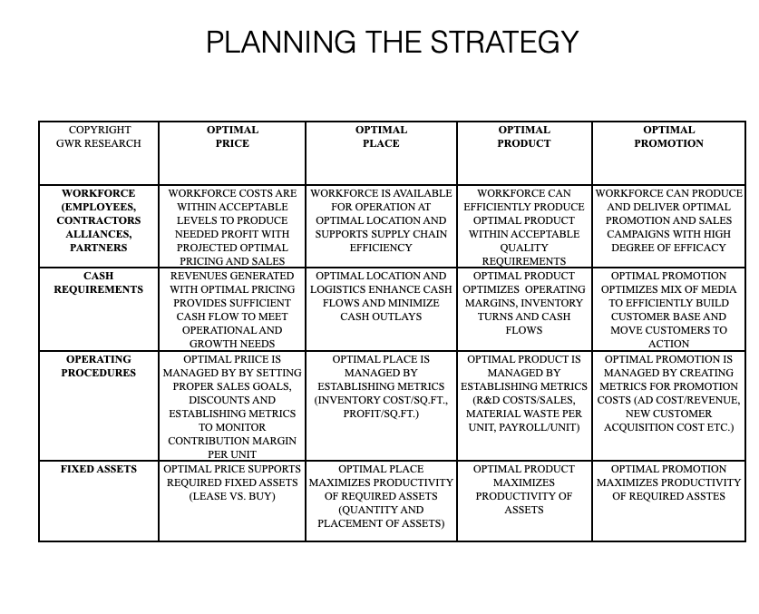
Notes:
A strategist would need to insure that Price, Place,Product and Promotion are aligned with Workforce, Cash requirements, Operating Procedures and Fixed Assets.

Slide 55
Workforce
Workforce Composition - Full Time, Part Time, Contractor, Vendor, Volunteer.
Workforce Compensation - Salary, Hourly, Piece Rate, Commission, Stock, Ownership
Workforce Logistics - Remote, Onsite, Distance To Travel, Cost To Cover Workforce Logistics

Slide 56
Cash Requirements
Cash Needed For Location, Furnishing, Utilities, Signage, Special Facilities - Lease Or Buy
Cash Needed For Workforce Pay For 6 Months To 1 Year
Cash Needed To Execute Promotion Strategy
Cash Needed For Inventory, Materials
Cash Needed For Production Equipment - Lease Or Buy
Cash Needed For Insurance, Benefits
Source Of Cash - Other Operations, Loans, Venture Capital, Stock Offering, Angel Investors, Partnerships With Vendors/Collaborators.

Slide 57
Methods
Metrics And Standards For Workforce - Turnover, Revenue Per FTE, Profit Per FTE, Output Per FTE Etc
Metrics For Logistics - Revenue/Sq. Ft., Inventory/Sq/Ft., Transportation Costs, Delivery Cost/Unit
Metrics For Cash Requirements - Days In Receivable, Discounts Earned, Inventory Turns, Days In Inventory, Cash Reserves,
Metrics For Machinery - Machinery Time In Use, Units Per Hour, Running Waste, Non Running Waste, R&M Cost Per Unit,

Slide 58
Capital Requirements
What Production Equipment Will Be Required.
Will A Building Be Required?
Will Furnishings Be Required?
Is It Better To Buy Or Lease?
Will Capital Come From Stock Offering, Loan, Angel Investors, Venture Capitalists, Personal Or Other?

Slide 59
Execution

Slide 60
Execution
Actions That Allow Tactics To Be Successfully Implemented
Planning
Organizing
Directing
Controlling

Slide 61
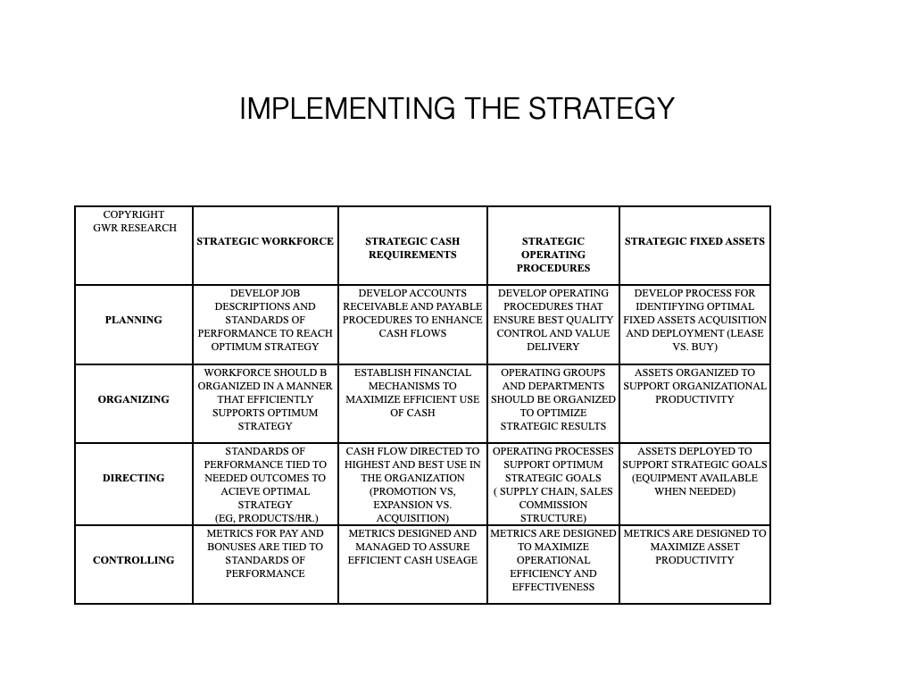
Notes:
Strategist should insure that there is a plan, organization, directions and controls for the workforce, cash, operating procedures and fixed assets.

Slide 62
Planning
Workforce Organization, Reporting And Measuring
Cash Flow Design - How Money Will Be Collected, Used And Invested
What Methods, KPIs And Other Metrics To Track Success
Lease Or Buy Machinery, How Will Machinery Be Utilized

Slide 63
Organizing
Organizing Workforce In A Manner That Promotes Efficiency And Effectiveness
Establish Procedures That Insure Cash Is Handled In Accordance With The Plan
Design Systems So That They Dovetail And Promote Success
Layout Of Equipment And Workspace Should Support Production Efficiency

Slide 64
Directing
Align Job Descriptions And Standards Of Performance With Overall Company Success
Set Cash Use And Management Procedures To Match Success Requirements
Choose Metrics To Regularly Measure Success Of All Segments Of The Business
Set Operating Procedures For Production That Assure Meeting Corporate Goals

Slide 65
Controlling
Measure Effectiveness Of Workforce Against Goals Established For Success (Standards Of Performance And KPIs)
Measure Cash Use Against Established Goals For Success(Standards Of Performance And KPIs)
Measure Procedures Established Against Established Goals For Success(Standards Of Performance And KPIs)
Measure Equipment Use And Production Against Established Goals For Success(Standards Of Performance And KPIs)

Slide 66
Standards of Performance Example
                Standards Of Performance - Sales
      Account Executive
            Responsibility Standard Metric (4 = 100%)
Provide Daily Sales Activity 1. Daily Entry In CRM 20 Entries = 4, 15 To 19 = 2
2 Cold Calls Per Week 2. Weekly Sales Report 2 Cold Calls = 4, 1 Cc=2
5 Sales Per Month 3. Monthly Sales Report 5 Sales = 4, 3 Sales = 2

Slide 67
Key Performance Indicators For Workforce
Payroll As A % Of Revenues
Employee Turnover
Payroll Actual Versus Budget
Revenue Per Fte
Units Sold / Employees

Slide 68
KPIs For Cash Management
Cash On Hand Vs Budget
Days In Receivable
Discounts Earned For Early Payment
Inventory Turns
Debt Payments As A % Of Revenues
Cash On Hand/ Operations Cost Per Day

Slide 69
KPIs For Equipment
Repair And Maintenance As A % Of Revenues
R&M Costs Vs Industry Average
Running Waste
Non Running Waste
Debt On Equipment As A % Of Liabilities

Slide 70
KPIs For Methods
Actual Revenues And Expenses Vs Budget
Actual Revenues And Expenses Versus Last Period (Monthly, Quarterly Or Annually)
Sales Per Employee Versus Last Period And Budget
Actual Operating Profit Versus Budget And Last Period.

