Slide 1
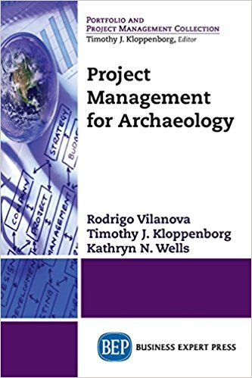
Highlights
for
Readers

Slide 2
Ch. 1: Archaeological Projects, Past and Present
Archaeology studies the artifacts people in the past left (either by accident or design). Gleaning knowledge regarding these people and their cultures by following the scientific method.
Covered in Chapter 1 are:
Different archaeological projects, actors and timelines.
Project Management definition and its usefulness to archaeological projects.

Slide 3
Ch. 1: Archaeological Projects, Past and Present
Archaeological projects require different approaches and understandings of rhythms, timelines and actors involved. For example:
Graduate research (academic)
Commercial (salvage)
Funded grant (institutional research)
These projects may have different relationships regarding success and client satisfaction (e.g institutions supporting your research, the public in general and local authorities).

Slide 4
Ch. 1: Archaeological Projects, Past and Present
Project Management is planning an undertaking and seeing it through to completion with customers successfully using the deliverables created. In archaeology, it implies the logistics, methodologies, proper timetables, actors involved and deliverables.
The Archaeological project’s timeline include:
Initiating (Research project)
Planning (Acquiring resources)
Executing (Field work)
Closing (Final reports)

Slide 5
Ch. 2: Initiating an Archaeology Project
Planning a research project requires organizing a team for the proper execution of the project, explaining rules and roles for you as project manager and other actors.
Covered in Chapter 2 are:
The processes to initiate an archaeological project.
Writing of a Charter and organizing your team.

Slide 6
Ch. 2: Initiating an Archaeology Project
Initiating a project requires: Need, validation and resources. These three concepts define the basis for the Project’s proposal.
With a written proposal, you need to write the different roles and responsibilities of all the stakeholders. This is the Project’s Charter (you can write a more specific Charter for your team).

Slide 7
Ch. 2: Initiating an Archaeology Project
An important exercise to ensure your team and other actors (like Sponsors and Directors) are on the same page is to develop Scope Overview (what) and a business case (why).
Milestones, Evaluation Criteria, Risk plans, etc. are also crucial for the proper drafting of your research proposal and following plan.

