Slide 1
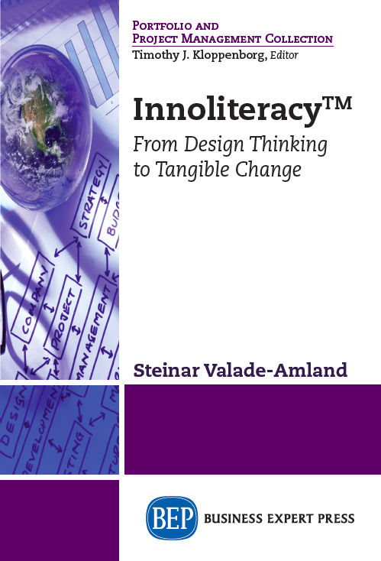
AN INTRODUCTION

Slide 2
PART 1: Innovation, Design Methodology, and the Current Design Discourse
INNOLITERACY takes its point of departure from the following takes on innovation:
Innovation means to create something new or improve something already existing, by which the perceived or real value of the product, service, process or transaction is higher than what was previously possible to deliver
Meaningful innovation is where a new or improved product or service, a new organisational or business model, or changed behaviour for the better as a whole contributes to a better experience for users and other stakeholders than any previously existing alternative.

Slide 3
Fundamental assumptions in the book
ON FRAMING
If the problem is not precisely identified, it makes little sense to solve it.
We spend most of our time and resources developing products and services that no-one really wants or needs, on treating symptoms instead of solving problems, on solving the most obvious and conspicuous elements of complex problems instead of searching for the core of the problem, while in best case buying ourselves some temporary relief, and in worst case creating a bunch of new problems.

Slide 4
Fundamental assumptions cont’d
ON REFLECTION
We seem to be more eager to “address” what is immediately visible than to take the time needed to make sure that we’re heading in the right direction. We reach out for the most conspicuous problem – without being clear about how it contributes to or fits into an overriding complex, strategy or objective.
One key to more meaningful innovation is to allocate more time and space to reflect, and INNOLITERACY dedicates an entire section on how reflection can be used strategically.

Slide 5
Composing a team for innovation
ON CREATIVITY AND CREATIVE MINDS
If we really want a systemic approach to any given situation, and as many different interventions as possible, we need to balance the team with regard to diverse types of rational and cognitive understanding, diverse points of view and backgrounds.

Slide 6
PART 2: Decisiveness and Reflection
ON BALANCING PERCEIVED EFFECTIVENESS AND SPEED ON ONE HAND AND TIME TO REFLECT ON THE OTHER:
We need a new paradigm with more reflection and more prudence, and at the same time more courage to fail and more consciousness around reading the weak signals. Far too many decisions are made – whether the situation craves it or not – hastily and on a feeble or faulty basis.

