Slide 1
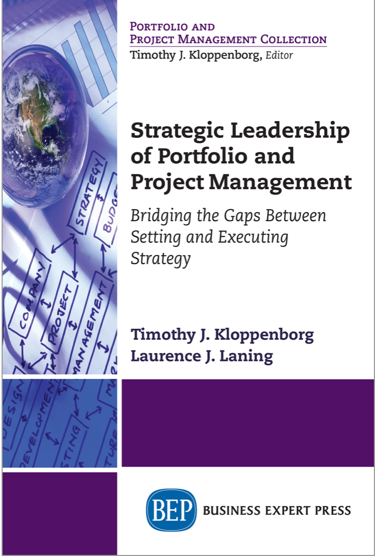
Highlights
for
Readers

Slide 2
Ch. 1: Implementing Strategy Through Portfolios and Projects
Executives set strategy
Managers implement strategy
Gaps often occur in execution

Slide 3
Chapter 1 Challenges
Competing objectives depending on organizational level, time horizon, or department
Projects as universal vehicles, project leadership roles, measuring project success
The need for standards

Slide 4
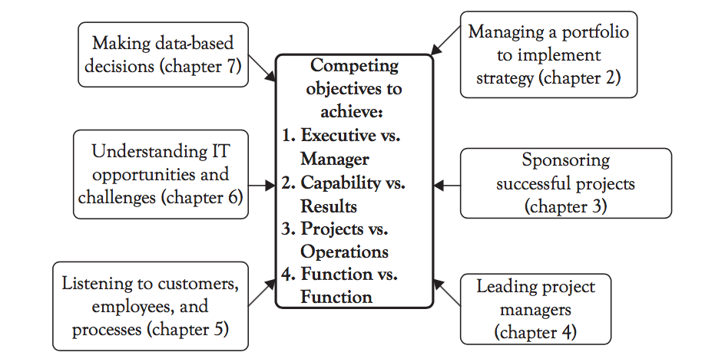
Overview of Remaining Chapters

Slide 5
Ch. 2: Managing a Portfolio to Implement Strategy: A Leadership Team Role
The purpose of this chapter is to provide guidance for all executives on how to:
identify,
select,
prioritize,
resource and
govern
a portfolio of projects that will best help you achieve your goals.

Slide 6
Identifying, Selecting, and Prioritizing Projects
Executives determine and communicate selection criteria
Everyone proposes potential projects
Executive team rates projects on each criterion
“Must do” and top rated projects are selected first

Slide 7
Resourcing and Governing Projects
Selected project have key resources assigned
Once key resources are fully loaded, no more projects are selected
Each resourced project is chartered
Executives govern lightly by considering vital signs at key milestones

Slide 8
Chapter 2 Takeaways
Managers need to articulate in proposals how each project will help achieve organizational goals
Executives need to explicitly rate each project on each previously defined criteria
Managers report on key project vital signs to executives at agreed to milestones

