Slide 1
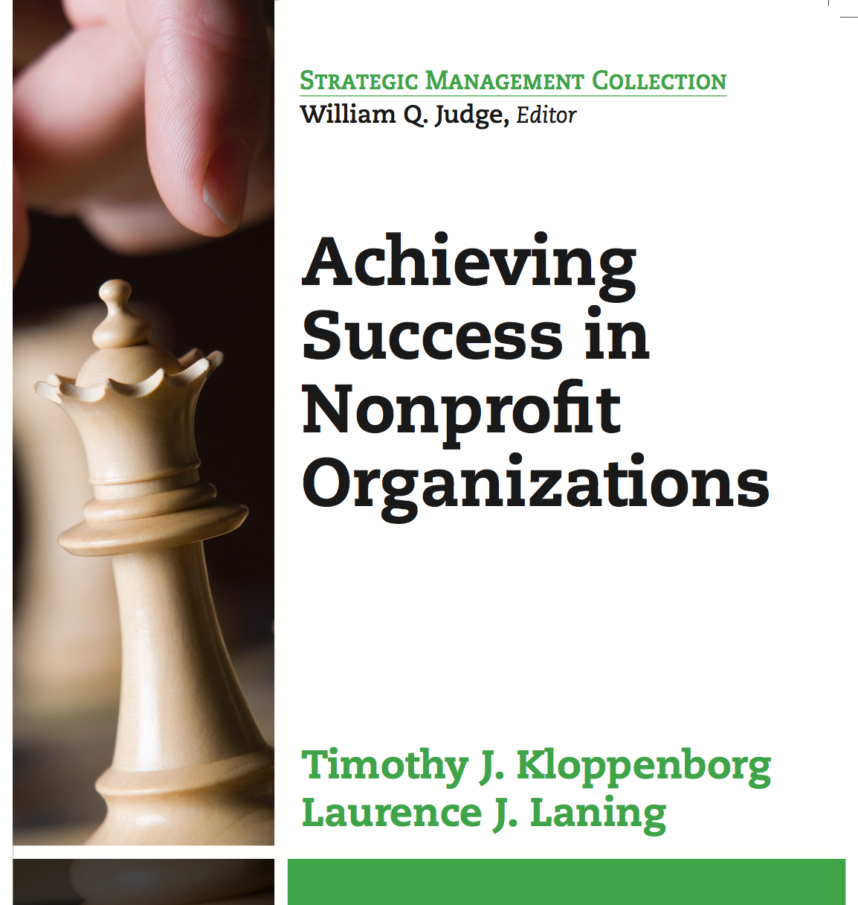
HIGHLIGHTS
FOR READERS

Slide 2
Chapter 1 - Introduction
This book is focused on key topics and skills needed by leaders of nonprofit organizations to successfully achieve their organization’s mission.
Topics identified by recent research conducted by the authors:
Literature Searches
Focus Group
Pilot Survey
Large Scale Survey of NP Leaders
Factor Analysis

Slide 3
Key Features of This Book
Each Chapter Written by Topic Experts
Learning Objectives for Each Chapter
Each Chapter Covers Essential 20% of the Topic That Results in 80% of the Overall Benefits
Current Relevant Case Studies
Key Assessment Questions for Each Chapter

Slide 4
Four Sections of the Book
Research Arrived at Four Strong Factors that Form the Major Sections of This Book:
Living the Mission
Making Good Decisions
Getting Things Done
Developing Your Team

Slide 5
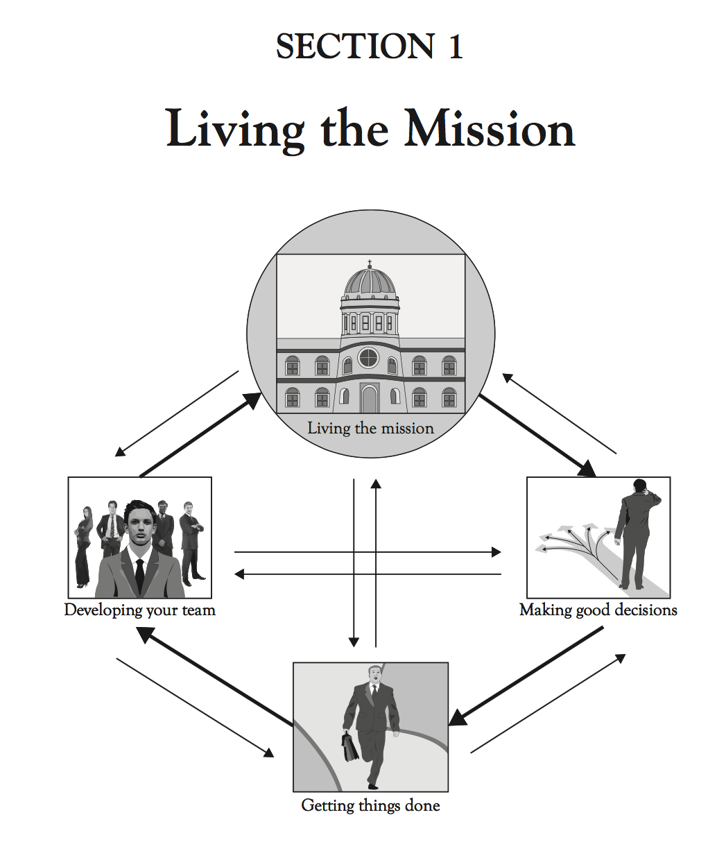
Ch. 2: Developing & Living
Your Mission
Ch. 3: The Board’s Role
Ch. 4: Walking the Talk
Ch. 5: Community
Engagement

Slide 6
Chapter 2 – Developing and Living Your Mission
It is essential that each nonprofit organization have a clearly defined purpose and direction that translates into specific behaviors and actions for what that organization DOES.
The purpose of this chapter is to show nonprofit leaders how to develop and live a relevant mission for their organization.

Slide 7
Living Your Mission Takeaways
Assess Your Organization’s Mission Relevance to the World You Operate In
Assess Whether or Not Your Mission Reflects What Your Organization Actually Does
Thinking Critically About Your Organizational Initiatives
Launch a Process to Improve Existing Programs and Creates New Ones

